Slide 1
Summary 02/09 Filip Krasniqi, Jocelyne Elias and Jérémie Leguay
September 02, 2019

Slide 2
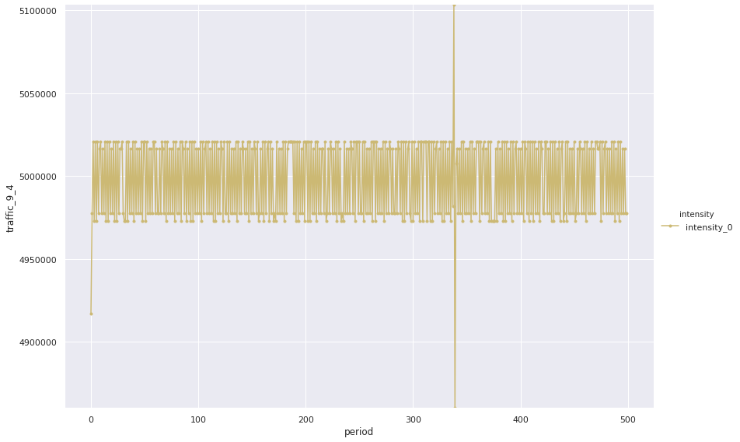
SIM (network = 10 nodes)
Evolution of traffic over time (bps)

Slide 3
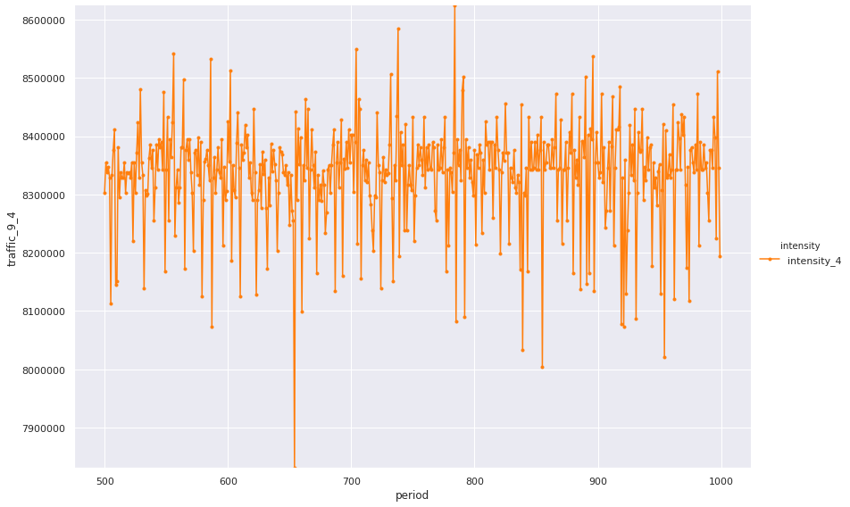
SIM
Evolution of traffic over time (bps)

Slide 4
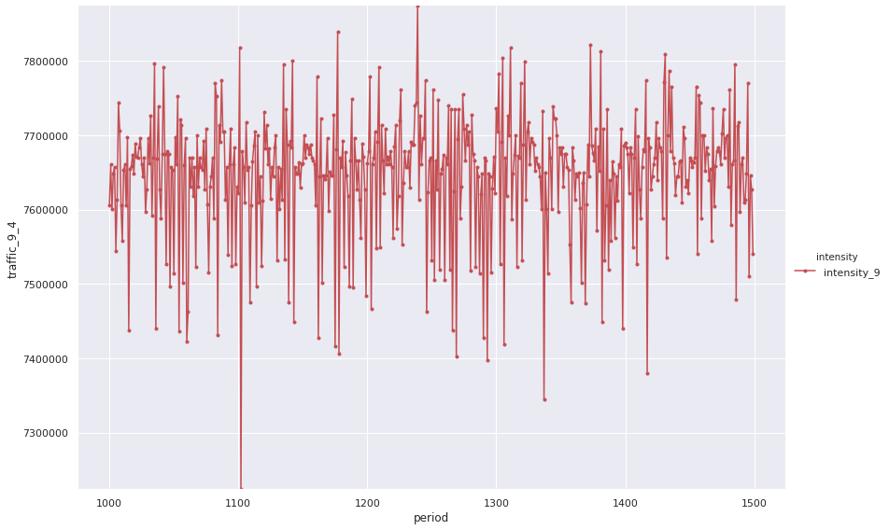
SIM
Evolution of traffic over time (bps)

Slide 5
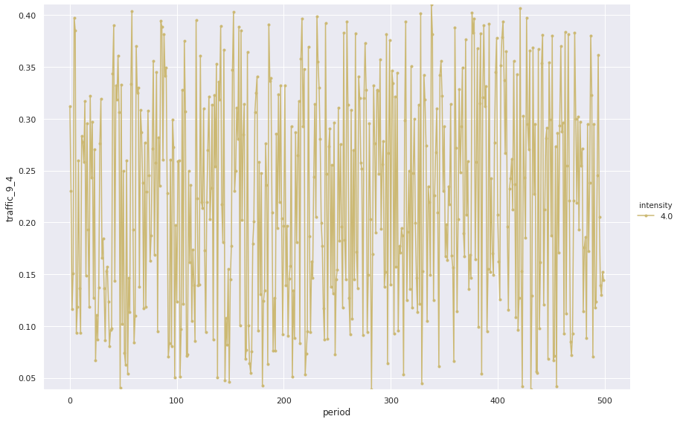
p1
Evolution of traffic over time (kbps)

Slide 6
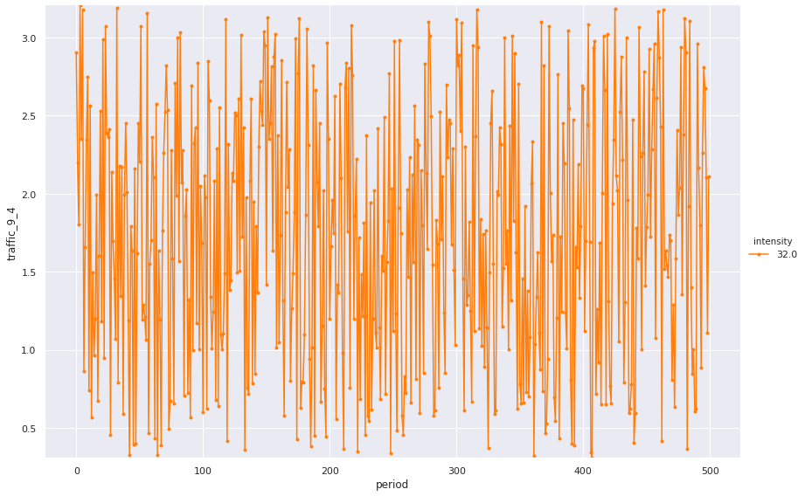
p1
Evolution of traffic over time (kbps)

Slide 7
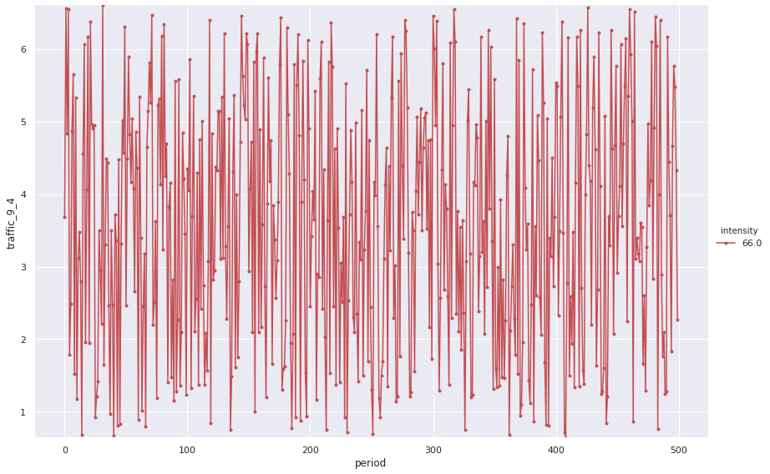
p1
Evolution of traffic over time (kbps)

Slide 8
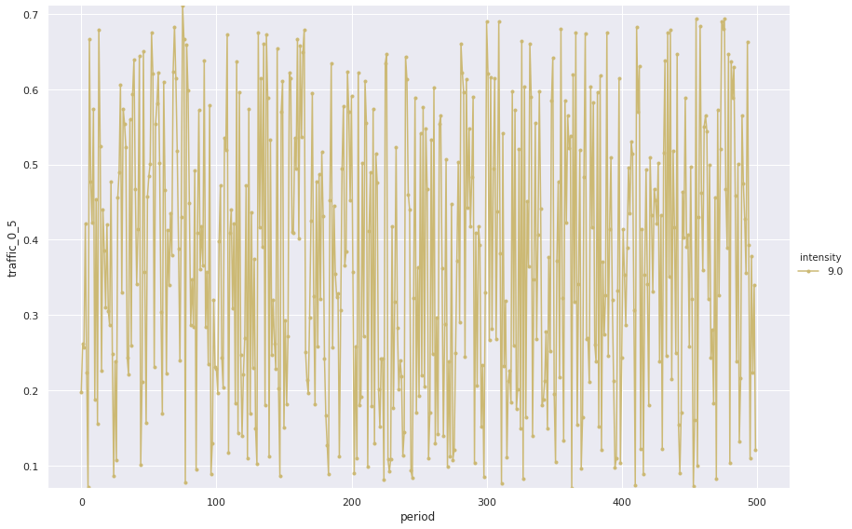
P3 (NB: different network, nsf = 14 nodes)
Evolution of traffic over time (kbps)

Slide 9
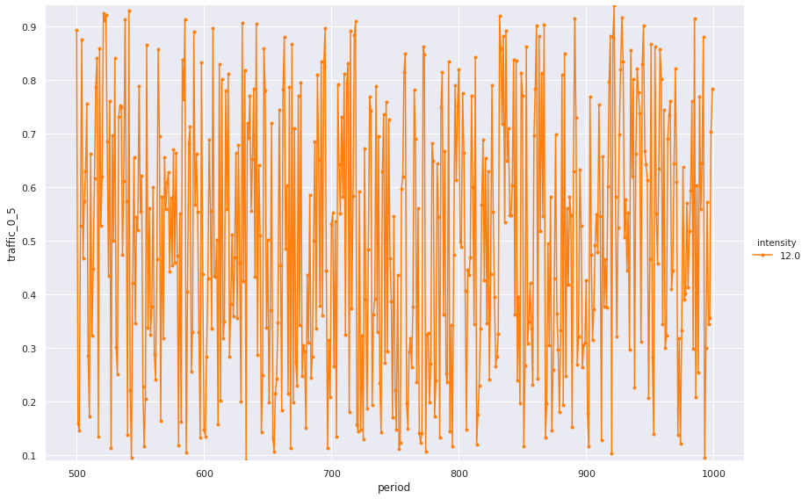
p3
Evolution of traffic over time (kbps)

Slide 10
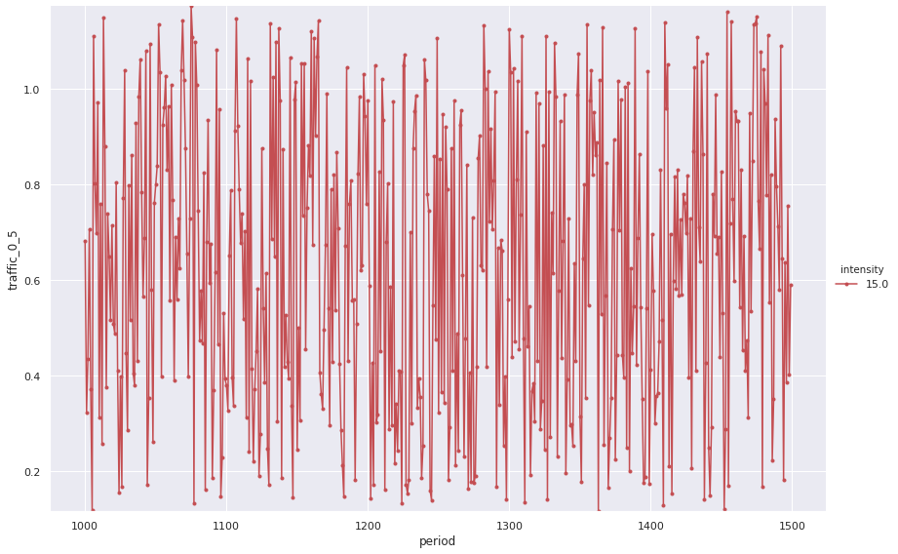
p3
Evolution of traffic over time (kbps)

Slide 11
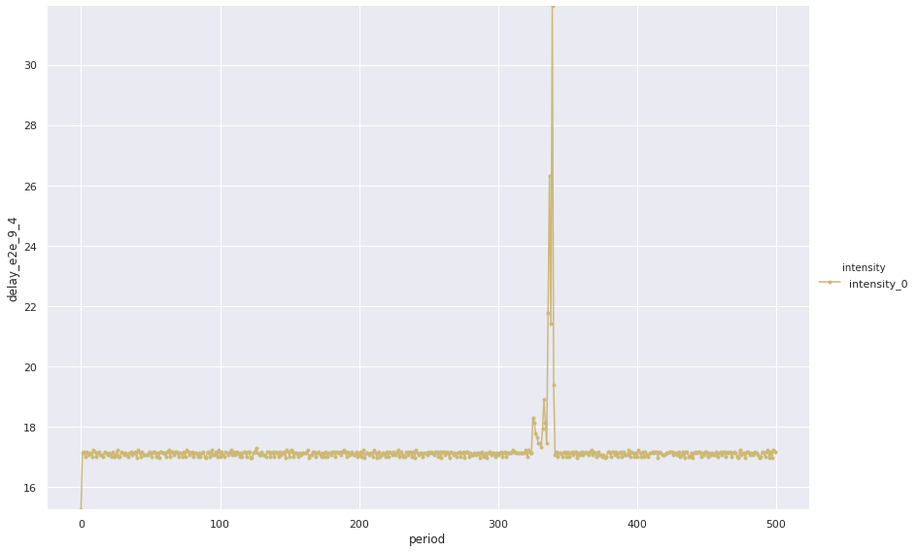
SIM
Evolution of delay over time (sec)

Slide 12
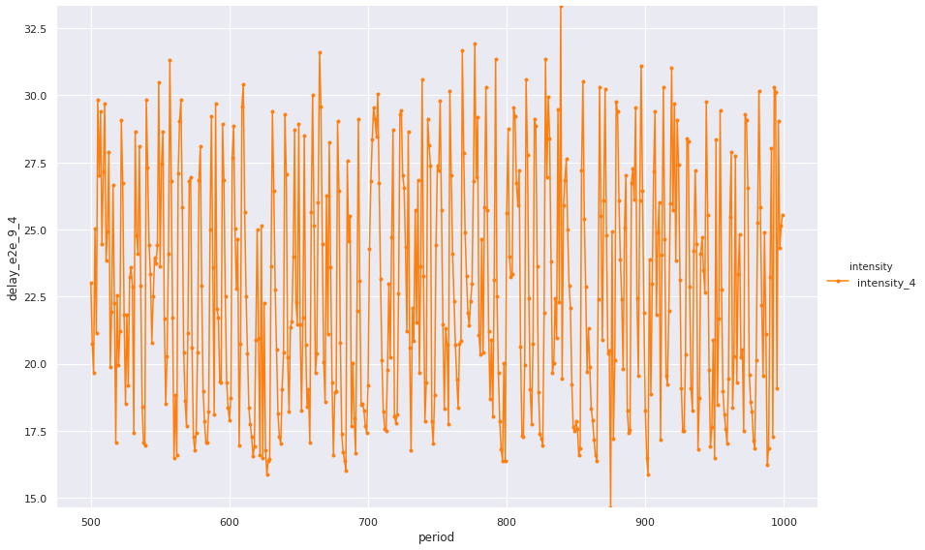
SIM
Evolution of delay over time

Slide 13
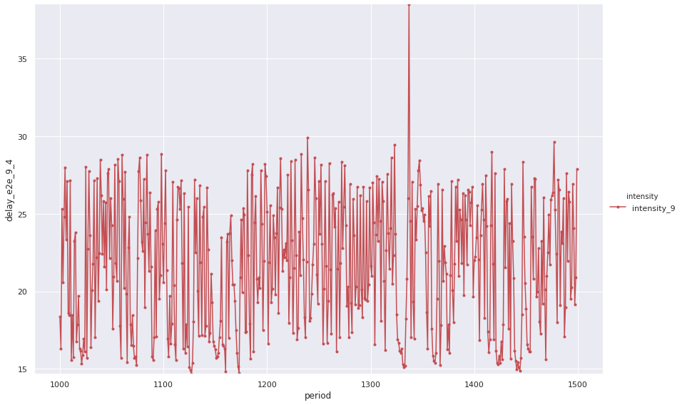
SIM
Evolution of delay over time

Slide 14
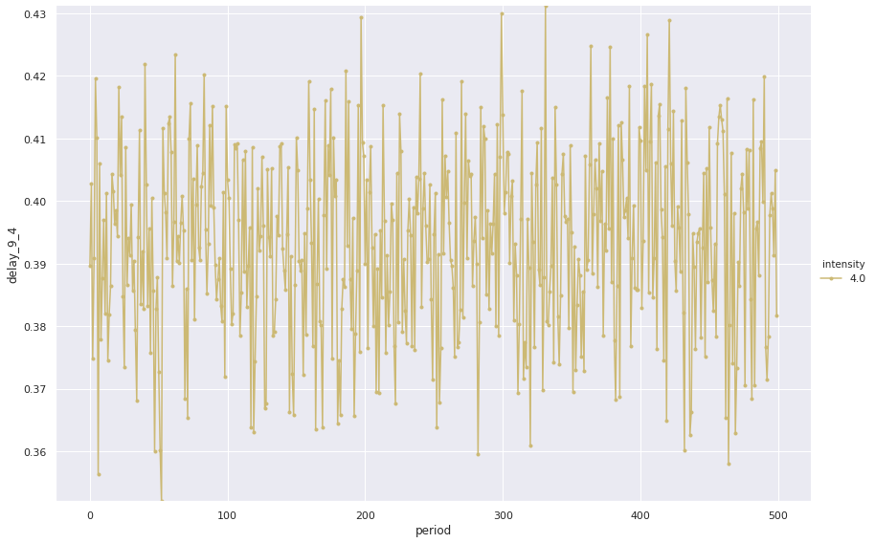
p1
Evolution of delay over time

Slide 15
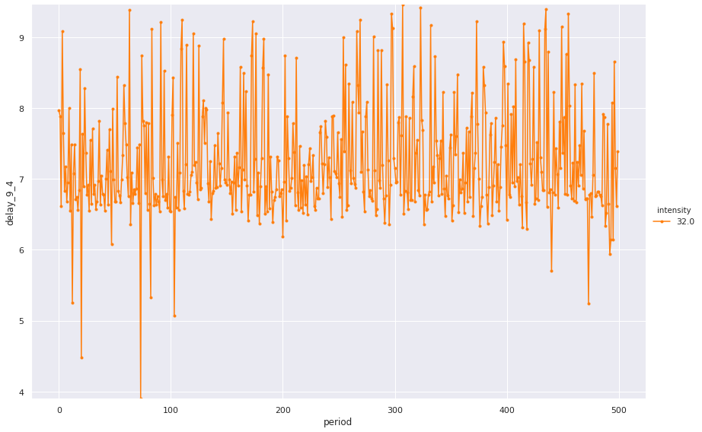
p1
Evolution of delay over time

Slide 16
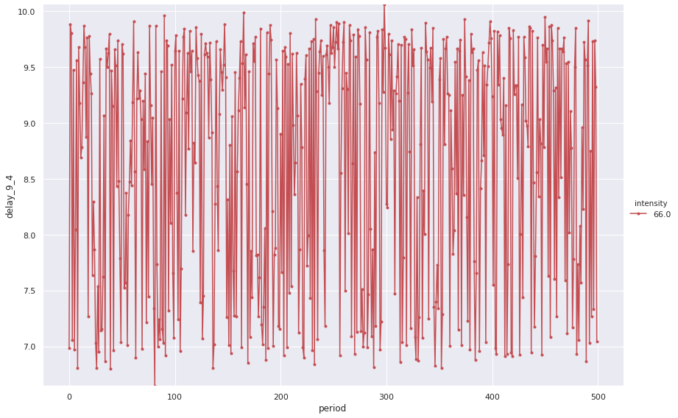
p1
Evolution of delay over time

Slide 17
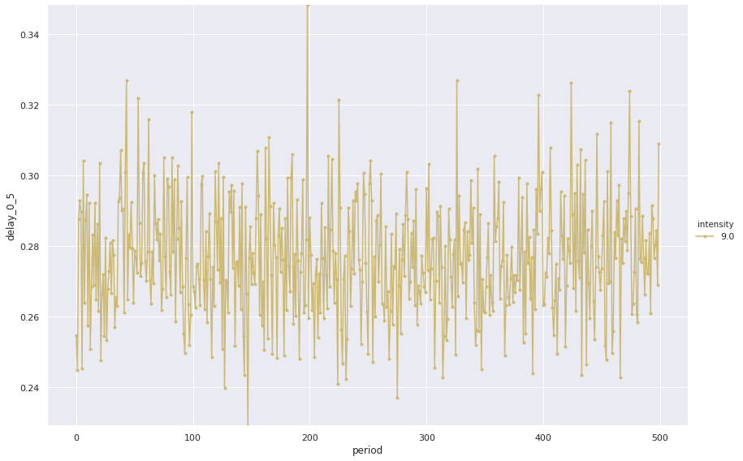
p3
Evolution of delay over time

Slide 18
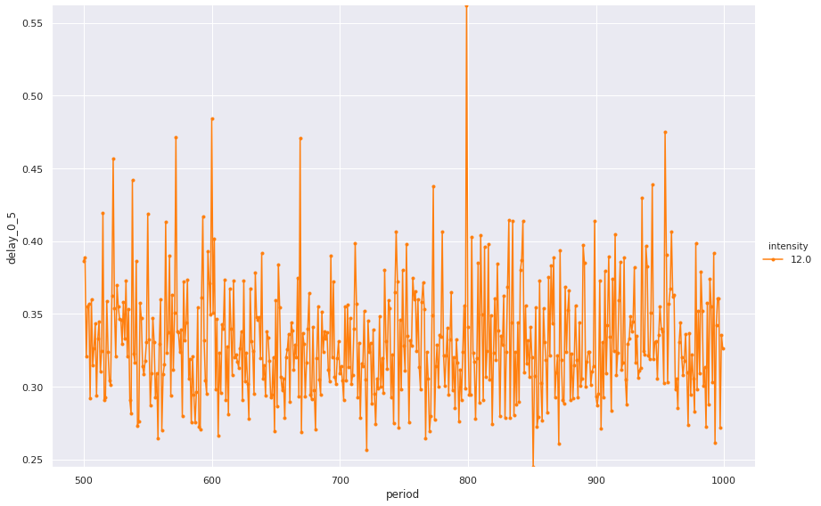
p3
Evolution of delay over time

Slide 19
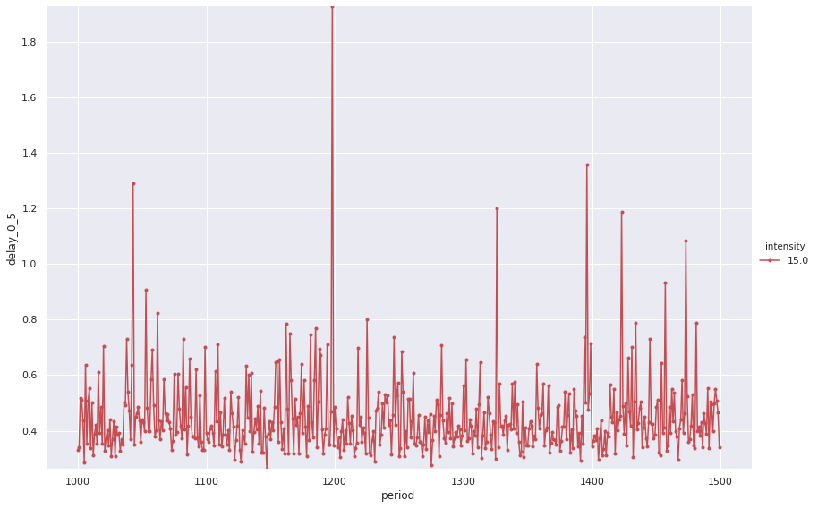
p3
Evolution of delay over time

Slide 20
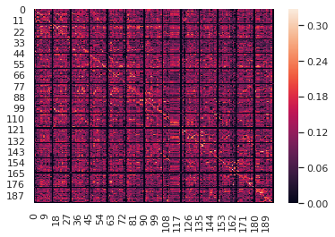
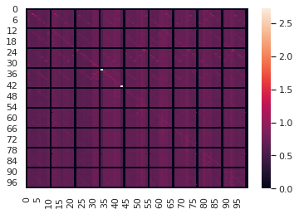
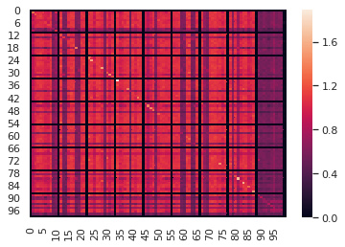
Mutual information (1/2)
P3,
fixed routing,
3 intensities
P1,
fixed routing,
3 intensities
SIM,
fixed simulation,
3 intensities

Slide 21
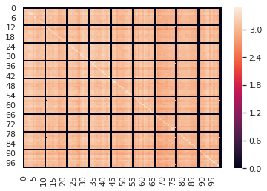
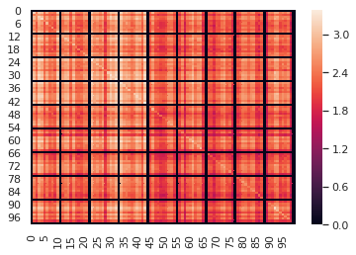
Mutual information (2/2)
SIM,
fixed intensity (low),
More simulations
SIM,
Fixed intensity (high),
More simulations

